Slide 1
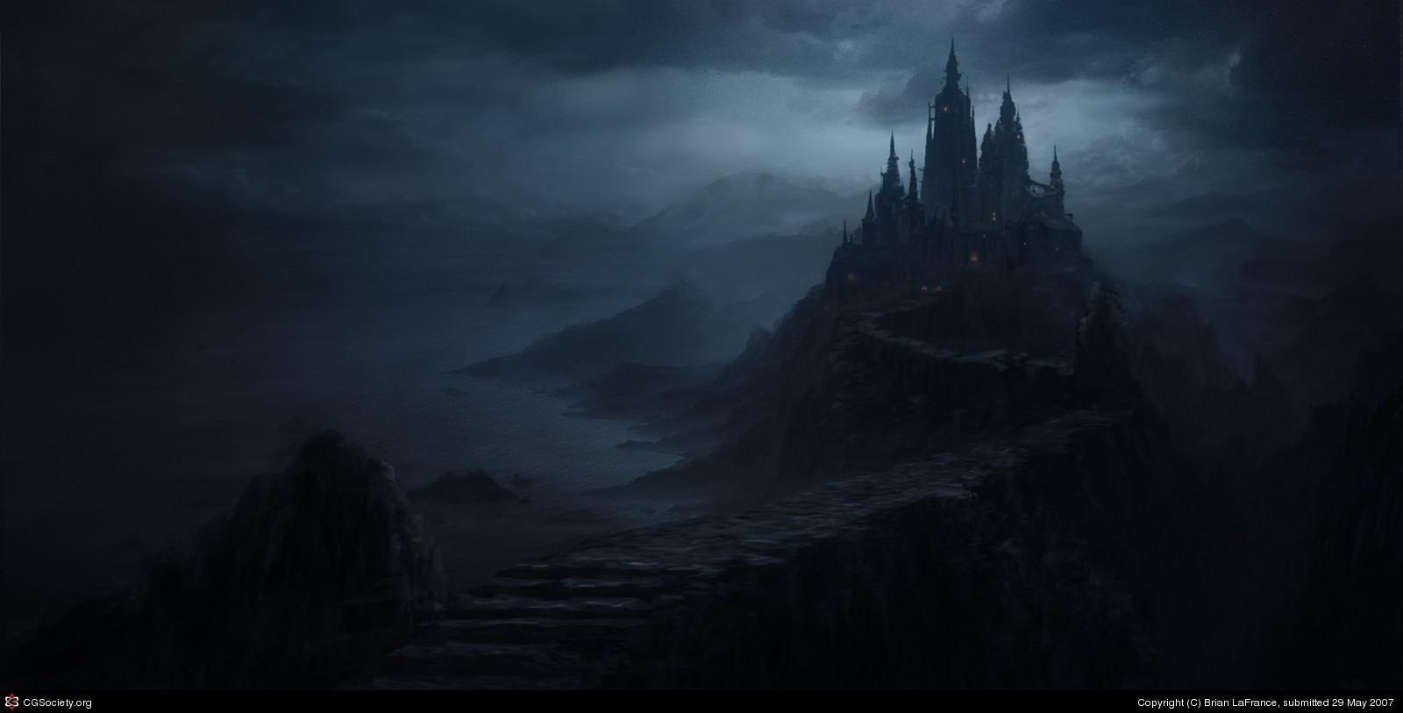
Castle of Maldocar
A game by team
“Gei Hinnom”

Slide 2
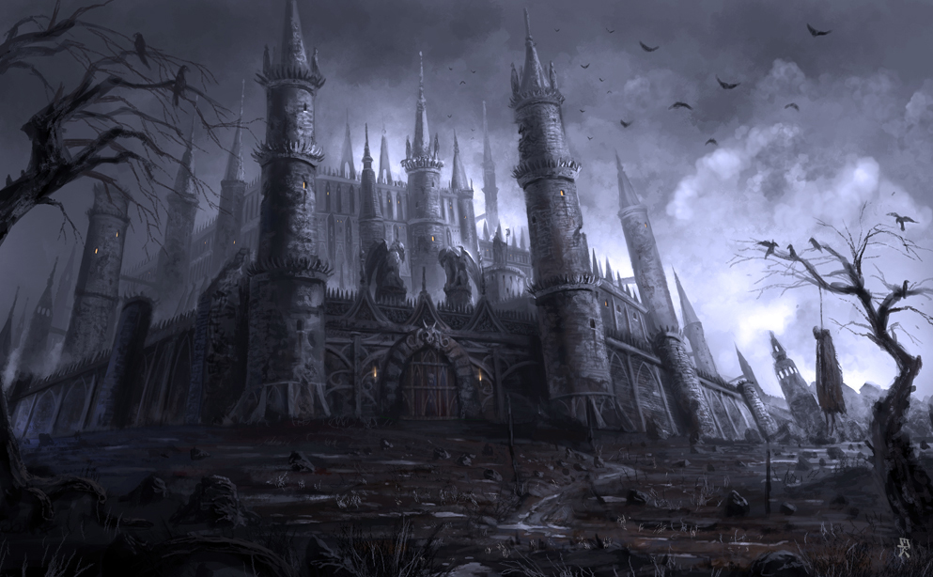
Back in the Dark Ages a warrior is imprisoned in a doomed castle, by a sinister force
which has become the castle's new master.
Using his wits and skills at survival, our hero
must now escape from captivity and free
the land from the evil menace.
Nothing is known about the enemy
except that he is cunning and
powerful enough to have defeated
the castle's last lord.
The path to freedom is long and full of mysteries,
but it is the only path before you.
Your life and your land's fate depend on you, as you struggle to
Escape the Castle of Maldocar

Slide 3
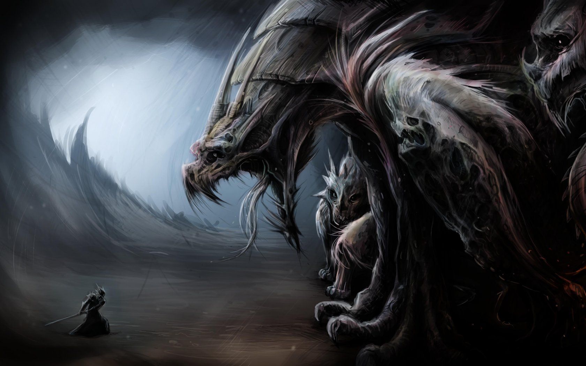
Viktoria Teneva
TEAM MEMBERS
Level Two (BeforeLast): “The hidden grave”;
Classes for game objects with properties;
Methods and collections defining special and forbidden coordinates for each level and adapting them to here current coordinates.
Game Frame Graphics;
Displaying dialogs;
Start screen;
Level One: “The Skull”;
Adding and removing items from the inventory;
Victory Screen;
Georgi Antonov

Slide 4
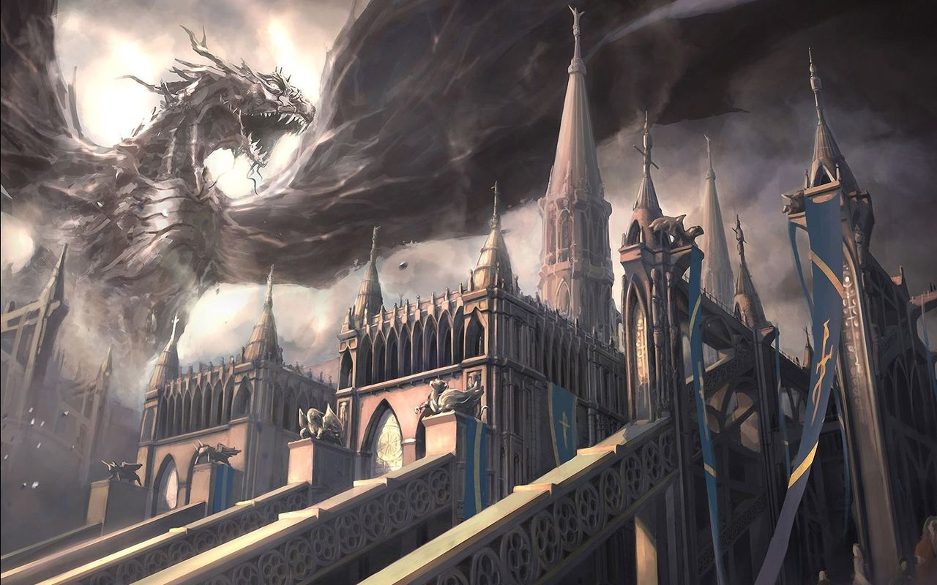
TEAM MEMBERS
Gancho Chankov
Basic hero movements and changes in hero’s printed character while moving in different directions.
Last level: “Final battle with the dragon”.
Hristian Enchev

